Slide 1

CMR COLLEGE OF ENGINEERING & TECHNOLOGY
Kandlakoya , Medchal , Hyderabad - 501401
Department of Computer Science and Engineering
Decentralized Crime Registry Platform using Blockchain Ethereum and web3
Name of the students:
20H51A05C5 – G . Venkata Muralidhar Reddy
20H51A05H2 – K . Sruthi
20H51A05H5 – K . Chandu
Batch no. :10
Under esteemed guidance of
DR.P. Senthil
(Assistant professor)

Slide 2
Outline
Abstract
Introduction
Literature survey
Existing System
Research Objective of Presentation
Problem Definition
Research work
Results
Conclusion
Future work
References
Notes:
2

Slide 3
Abstract
Notes:
3

Slide 4
ABSTRACT
Traditional record-keeping systems might involve a lot of paperwork and manual processes to retrieve information. With a blockchain-based system, authorized individuals, like judges, lawyers, or law enforcement, can access the required records quickly and efficiently. This can help speed up legal processes.
When information about crimes is added to the blockchain, it becomes very difficult to change. This creates a high level of trust in the accuracy and integrity of the data. Courts can rely on this data, knowing that it hasn't been manipulated. Once a crime record is added to the blockchain. Since blockchain records are cryptographically secure and can't be easily changed, it reduces the chances of fraudulent activities, such as someone trying to manipulate or forge crime records

Slide 5
INTRODUCTION
Notes:
5

Slide 6
Introduction
In the realm of legal processes and criminal record management, the transition from traditional paper-based systems to innovative, blockchain-powered solutions has revolutionized the way authorized individuals access, store, and trust crucial information. This project, built on a foundation of cutting-edge technologies, is designed to streamline and enhance the management of criminal records for judges, lawyers, law enforcement agencies, and other authorized personnel.
Traditional record-keeping systems often relied on paperwork and manual processes, leading to inefficiencies, delays, and the risk of errors. The adoption of a blockchain-based system has radically transformed the landscape. This innovative system enables authorized individuals to access essential records swiftly and efficiently, significantly expediting legal processes.
Notes:
6

Slide 7
Literature Survey
Notes:
7

Slide 8
Comparison table for the existing system
S.No | Authors and Journal Name& Year of publication | Problem Statement | Name of the Proposed solution/Method | Solution | Remarks
1 | Criminal record management system using Php and Mysql Author: Anuj kumar Osman Yahaya | Traditional criminal management system are manual like paper work. Time consuming and no proper security to the data. This project will overcomes manual work and significantly improving law enforcement efficiency. | It leverages modern technologies to deliver a robust application capable of meeting the dynamic needs of today's digital marketplace. | Criminal Record Management System using PHP for server-side scripting, MySQL for database storage, and HTML, CSS, and JavaScript for frontend development. Implement secure input validation, authentication mechanisms, and encrypted connections to ensure data integrity and user privacy. | PHP and MySQL are two popular open-source technologies that are often used to develop web applications, including criminal record management systems.
2 | Crime record management using asp.net framework Author : Deepak kumar | It focuses on development using the Asp.net framework, individuals often struggle to keep up with the latest tools and frameworks, hindering their ability to create efficient and interactive websites. | Author propose a detailed exploration of the Asp.net framework and delving into its core components, server-side functionalities, and advanced features. | Criminal Record Management System using ASP.NET framework for server-side scripting, C# programming language, and Microsoft SQL Server for database storage. Employ HTML, CSS, and JavaScript for the frontend interface, ensuring secure authentication, input validation, and adherence to ASP.NET security best practices | ASP.NET applications typically run on Windows servers, which can limit flexibility and scalability if there's a need to deploy the system on different platforms or cloud services.

Slide 9
Comparison table for the existing system
S.No | Authors and Journal Name& Year of publication | Problem Statement | Name of the Proposed solution/Method by authors | Solution | Remarks
3 | Django based crime record management Authors Pretham Kuldeep Baban | ASP.NET Framework can be complex and expensive to develop and maintain. Django-based systems are more lightweight and affordable, making them a better option for organizations with limited resource | Django is a free and open-source framework, while ASP.NET Framework is a proprietary framework. This means that Django is more affordable than ASP.NET Framework int terms of features. | Develop the Crime Record Management System using Django framework for backend logic, combined with HTML, CSS, and JavaScript for frontend components. Implement secure authentication, input validation, and encryption techniques to ensure data security, and utilize PostgreSQL as the secure database backend for storing sensitive criminal records | Django-based criminal record management systems are lightweight, affordable, and easy to use, but may not be suitable for large enterprise organizations.
4 | Crime record management using blockchain Authors: Shraddha Sanjay Pakale Muhammad Aamir Khan | Traditional systems are often vulnerable to cyberattacks. Blockchain systems are much more difficult to hack, as they are decentralized and have no central point of failure. | The blockchain solution would be implemented using a distributed ledger technology such as Ethereum or Hyperledger Fabric. The data model would include information about crime records, law enforcement officers, and other stakeholders. | All crime records would be stored on a decentralized blockchain network. This would make the records tamper-proof and secure. Authorized users, such as law enforcement officers and judges, would have access to the blockchain to view and update crime records. | These systems are more secure, transparent, and efficient than traditional systems. However, they are also more complex and expensive to develop and implement

Slide 10
Implementation of Existing System
criminal record management using ASP.net framework
The implementation of the Crime Registration System harnesses the robust features of the.NETframework to create a secure and efficient platform. Beginning with user authentication and login pages, the system ensures authorized access for users and administrators.
The Police Stations Registration module captures detailed information about registered police stations, integrating employee data seamlessly. The Victims FIR Registration module systematically records essential details for first investigation reports, ensuring structured crime data capture.
Meanwhile, the Investigating Evidence Registration module dynamically catalogs vital evidential data, adapting to the changing nature of investigations.

Slide 11
Implementation of Existing System
Crime record management using php and mysql
The implementation of the Online Crime Record Management System involves leveraging PHP and MySQL’s capabilities. User authentication and login mechanisms are created to ensure secure access for admins, police staff, and users.
The system’s modular design enables seamlessinteraction between admin, police, and user interfaces. Admin functionalities include managing police stations, staff, and crime categories, along with generating comprehensive reports. Police staff can handle FIR requests, manage criminals, and generate charge sheets, ensuring efficient workflow. Users can easily file FIRs, monitor their status, view charge sheets, and search records.
Criminal record management using java swing API
The Crime Record Management System’s implementation involves leveraging Java Swing API’s GUI components to create secure authentication and login pages.
The intuitive interfaces for Admin, Police Staff, and Users are designed to streamline interactions. Admin functionalities, including police station and staff management, are implemented using event- driven programming. Police staff can efficiently handle FIR requests and manage criminal records through dynamic UI elements.
Users can easily file FIRs, track statuses, and access charge sheets, enhancing transparency and user satisfaction.

Slide 12
Research Objective
Notes:
12

Slide 13
Research objective
To explore and implement the potential benefits of blockchain technology in the context of legal record-keeping systems.
This project aims to investigate how blockchain technology can be utilized to improve the efficiency, security, and integrity of legal record-keeping processes. It seeks to address the challenges associated with traditional paper-based systems by leveraging blockchain's immutability, cryptographic security, and transparency to create a more reliable and efficient system for storing and accessing legal records.
Through this research, the project seeks to determine the practicality and advantages of adopting blockchain solutions in modernizing legal processes. It aims to provide insights into how blockchain can revolutionize traditional record-keeping methods, ultimately benefiting legal professionals, stakeholders, and the broader society by establishing a more efficient and trustworthy legal system.

Slide 14
Problem Definition
Notes:
14

Slide 15
Problem Definition
The traditional methods of criminal record management and legal information retrieval are plagued by inefficiencies, lack of trust, and susceptibility to manipulation and fraud. These issues hinder the smooth functioning of the legal system and can result in delayed justice and compromised data integrity. The problem can be defined as follows:
1. Inefficiency in Record Retrieval:
Paperwork and Manual Processes: Traditional record-keeping systems often rely on paperwork and manual processes, leading to significant delays in accessing critical information. This inefficiency can result in prolonged legal proceedings.
Duplicate Records
Lack of Data Trustworthiness
Data Security Concerns

Slide 16
Research Work
Notes:
16

Slide 17
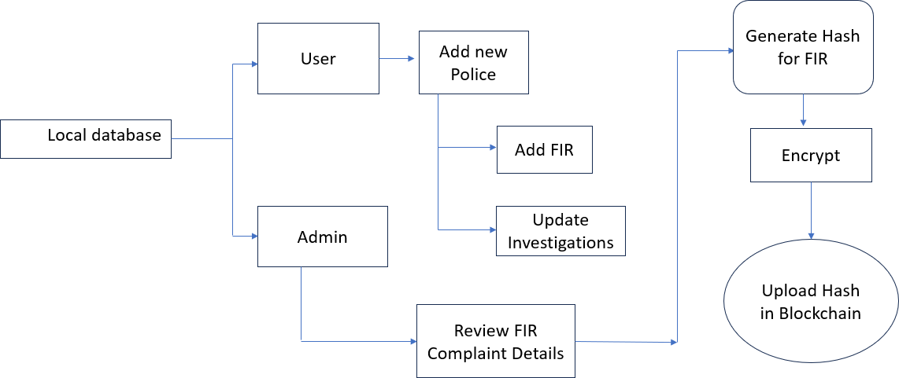
Proposed System Architecture

Slide 18
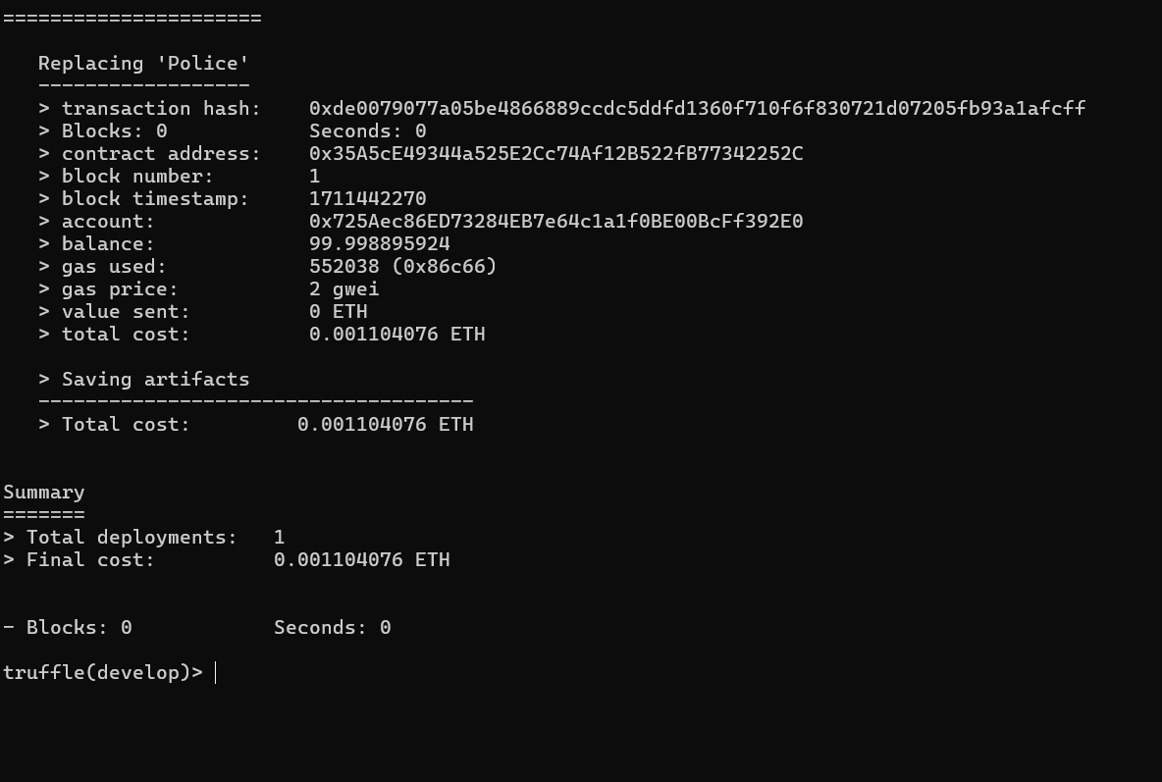
Result
Fig -1 Creating smart contract

Slide 19
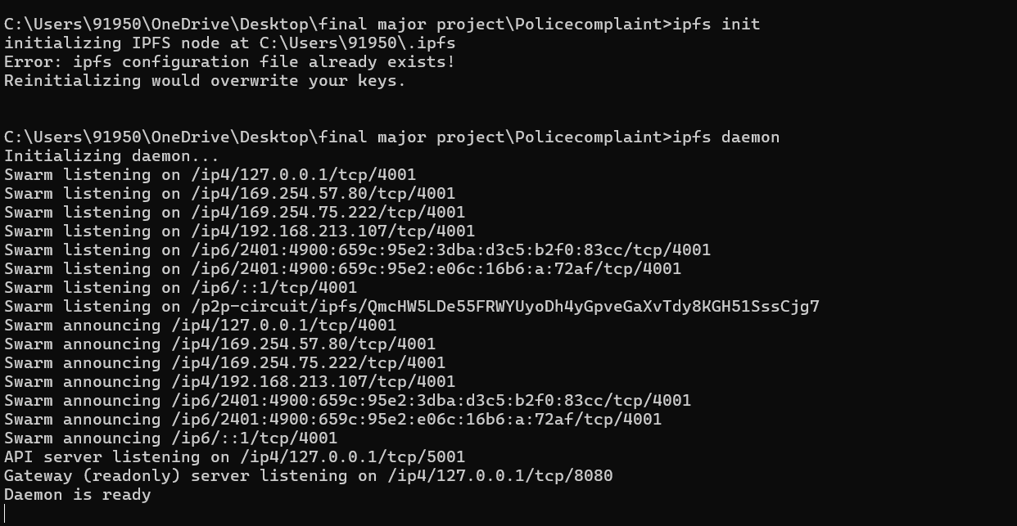
Result
Fig – 2 Starting IPFS

Slide 20
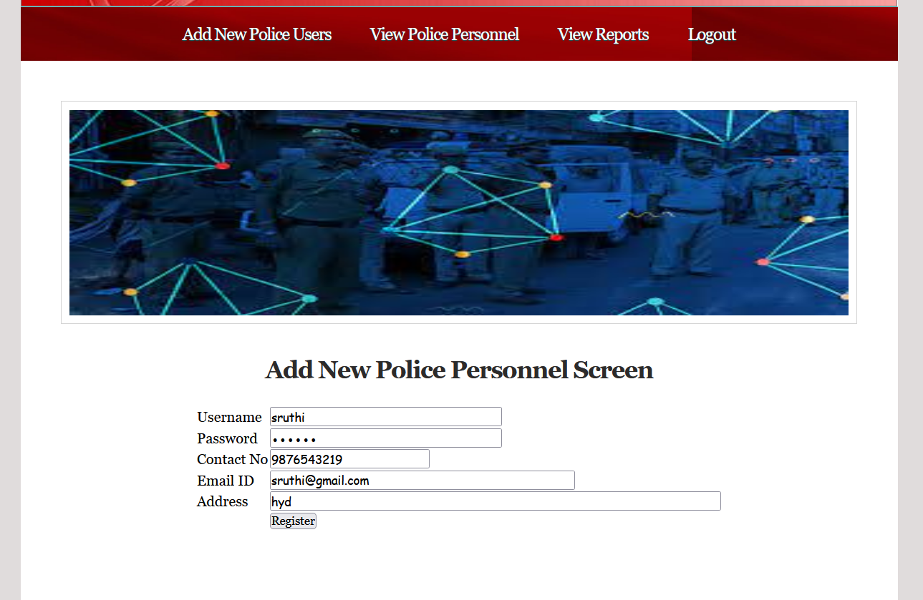
Result
Fig – 3 Adding police personnel screen

Slide 21
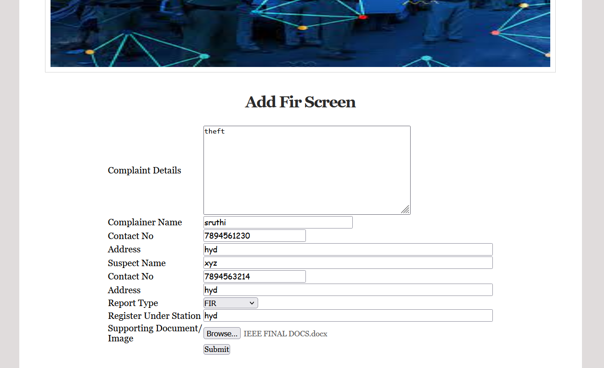
Result
Fig – 4 Adding FIR screen details

Slide 22
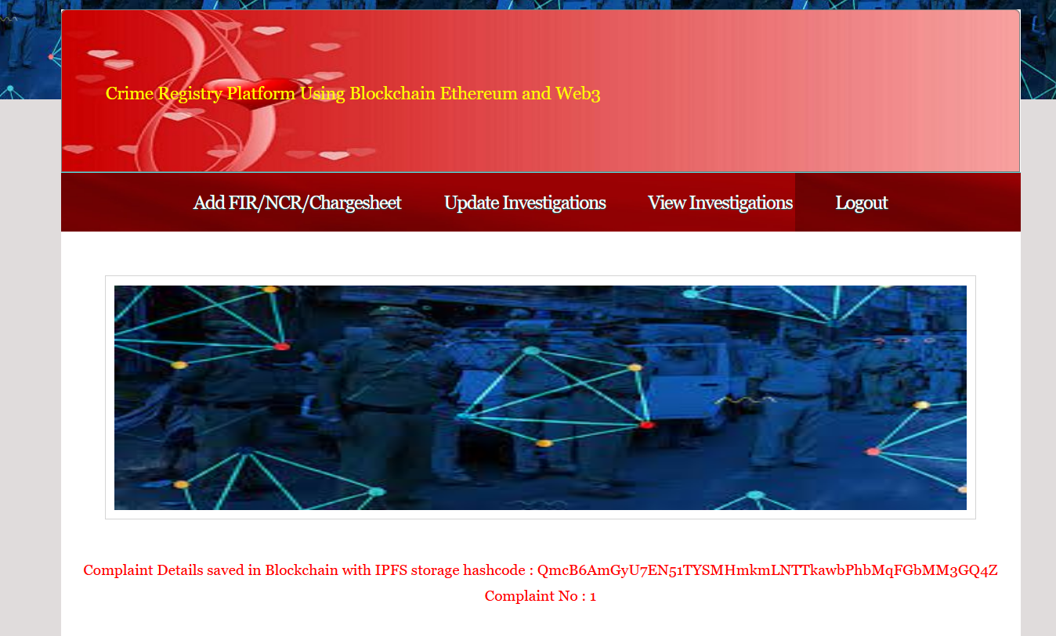
Result
Fig – 5 Storing complaint details in Blockchain

Slide 23
Conclusion
In conclusion, the implementation of a blockchain-based record-keeping system for legal processes is a significant step forward in enhancing the efficiency, security, and trustworthiness of the legal system. By utilizing technologies such as ReactJs, Bootstrap, NodeJs, MongoDB, Ethereum, and web3, we have created a robust and reliable platform that addresses many of the challenges associated with traditional paper-based systems.
The blockchain technology integrated into the system has ensured the highest level of data integrity. Once information related to crimes is added to the blockchain, it becomes virtually immutable and cryptographically secure. This inherent immutability instills a significant level of trust in the accuracy and reliability of the records. Courts and other stakeholders can confidently rely on this data, knowing it remains unaltered and tamper-proof.

Slide 24
Future Work
In conclusion, the implementation of a blockchain-based record-keeping system for legal processes is a significant step forward in enhancing the efficiency, security, and trustworthiness of the legal system. By utilizing technologies such as ReactJs, Bootstrap, NodeJs, MongoDB, Ethereum, and web3, we have created a robust and reliable platform that addresses many of the challenges associated with traditional paper-based systems.
The blockchain technology integrated into the system has ensured the highest level of data integrity. Once information related to crimes is added to the blockchain, it becomes virtually immutable and cryptographically secure. This inherent immutability instills a significant level of trust in the accuracy and reliability of the records. Courts and other stakeholders can confidently rely on this data, knowing it remains unaltered and tamper-proof.

Slide 25
References
Muyanja, A., Musasizi, P. I., Nassimbwa, C., Tickodri-Togboa, S. S., Kayihura, E. K., & Ngabirano,A. (2013, July). Requirements engineering for the uganda police force crime records management system. In 2013 21st IEEE International Requirements Engineering Conference (RE) (pp. 30-307). IEEE.Google ScholarCross Ref
Tasnim, M. A., Al Omar, A., Rahman, M. S., & Bhuiyan, M. Z. A. (2018, December). Crab: Blockchain based criminal record management system. In International conference on security, privacy and anonymity in computation, communication and storage (pp. 294-303). Springer, Cham.Google ScholarCross
Carrier, B., & Spafford, E. H. (2003). Getting physical with the digital investigation process. International Journal of digital evidence, 2(2), 1-20Google Scholar
Faber, B., Michelet, G. C., Weidmann, N., Mukkamala, R. R., & Vatrapu, R. (2019). BPDIMS: A blockchain-based personal data and identity management system.Google Scholar
Shukla, P., Tyagi, R., & Tyagi, A. Implementation of Blockchain on Criminality Record Checker.Google Scholar

Slide 26
Thank You!

